Slide 1
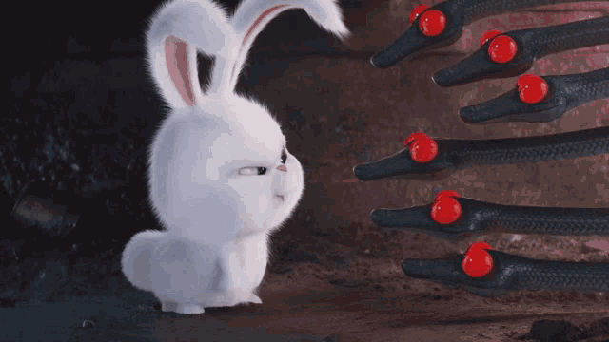
Can we help Snowball?

Slide 2

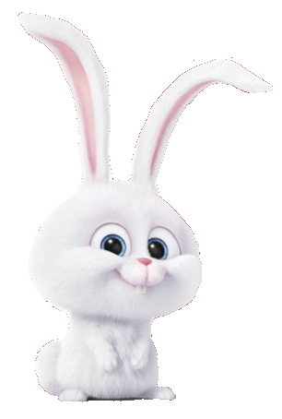
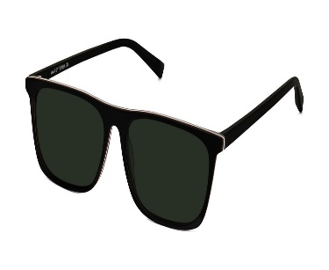
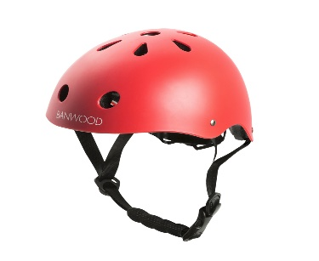
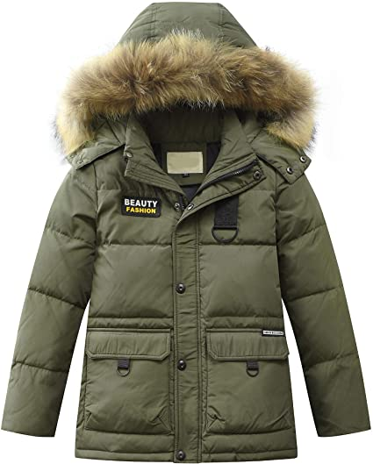
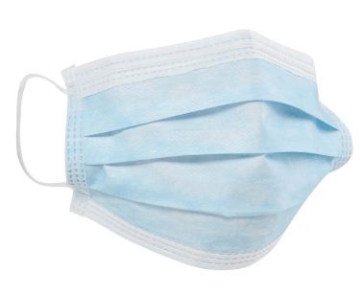
It´s very sunny outside. The light is very bright.
What should Snowball wear?
Sunglasses
Helmet
Winter Coat
Mask

Slide 3
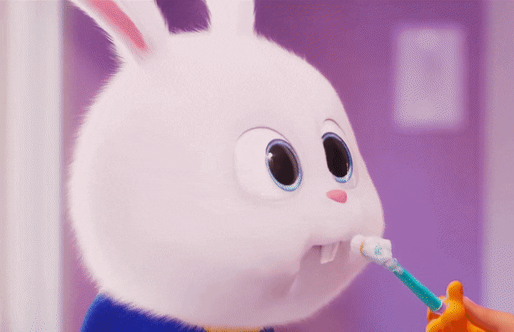
That is correct!
Well done!

Slide 4
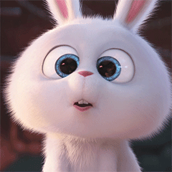
Wrong answer!
Please, try again!

Slide 5
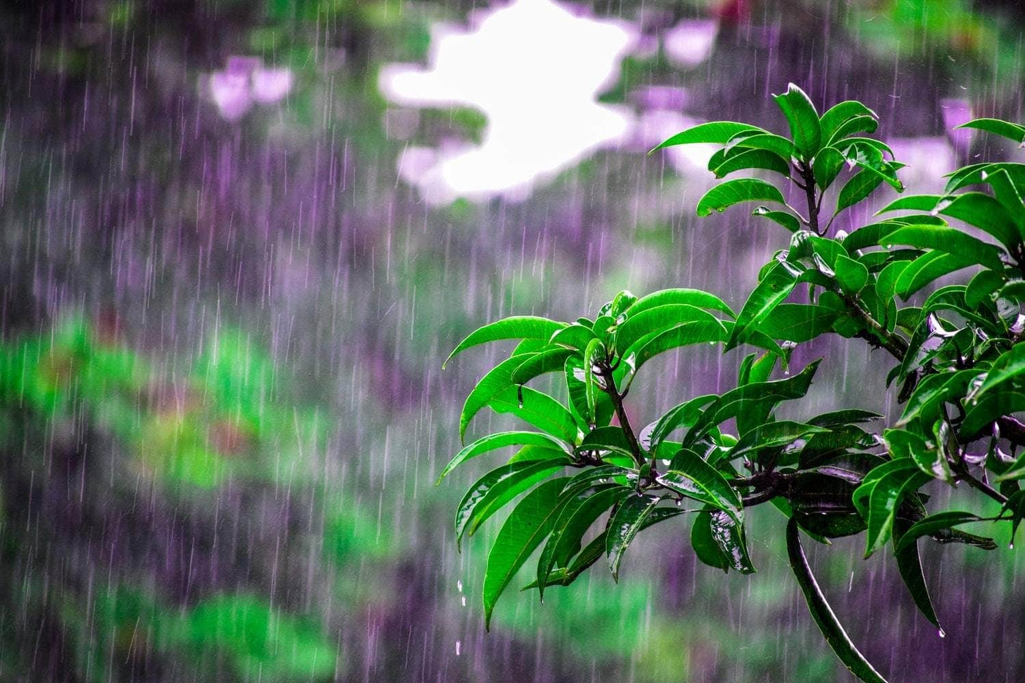
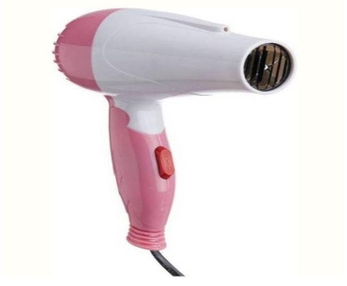
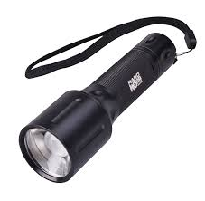
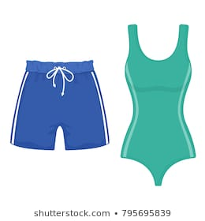
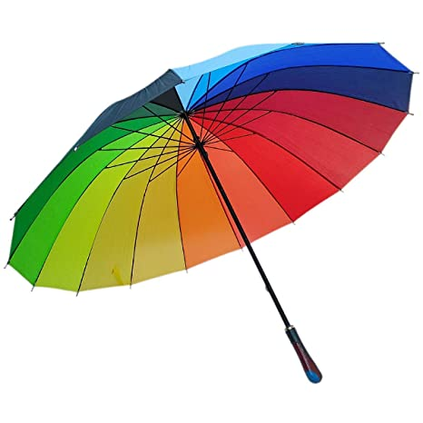
It´s raining outside. Everything is getting wet.
What should Snowball use?
Hair Dryer
Lantern
Swimming Suit
Umbrella

Slide 6
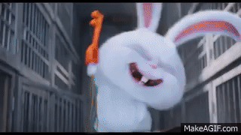
You are absolutely right!
Nice Work!

Slide 7
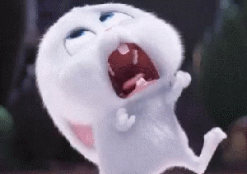
What?... That is incorrect, my friend!
We must keep trying!

Slide 8
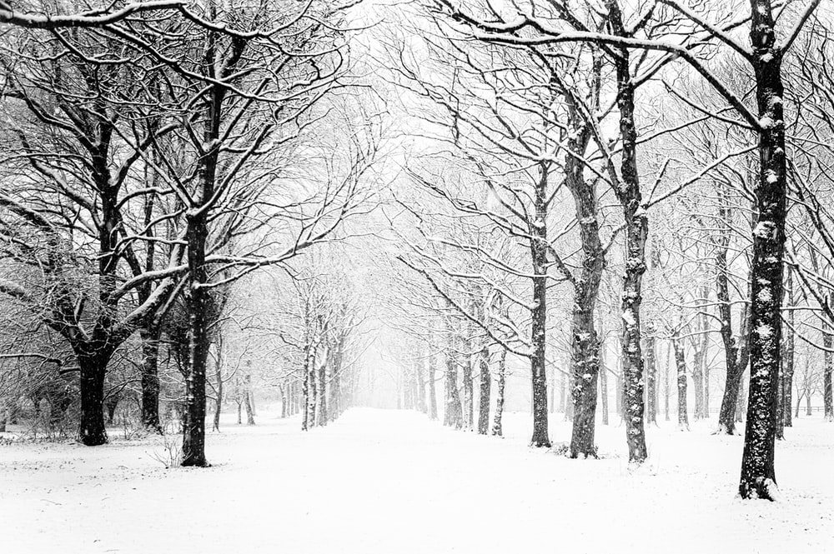


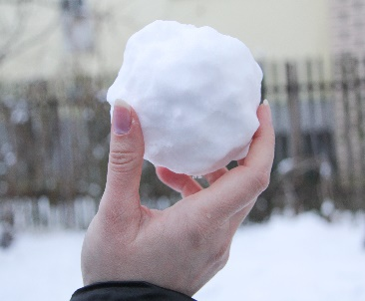
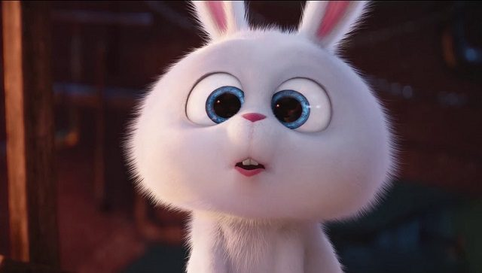
It´s snowing! Brrr… so cold!
What should Snowball use against the cold snow?
Poison
Ball
Snowball
Snowball
Winter Coat

Slide 9
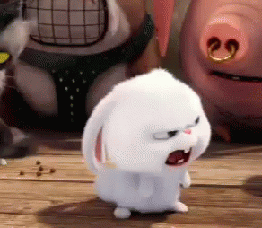
You should NEVER use poison, under ANY case.
You should know this!

Slide 10
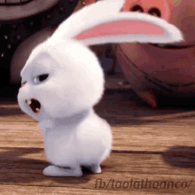
Yes! You are so smart!
Amazing!

Slide 11
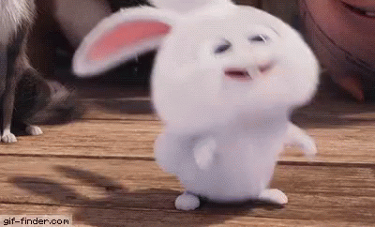
That is not the correct answer!
Let´s try again!

Slide 12
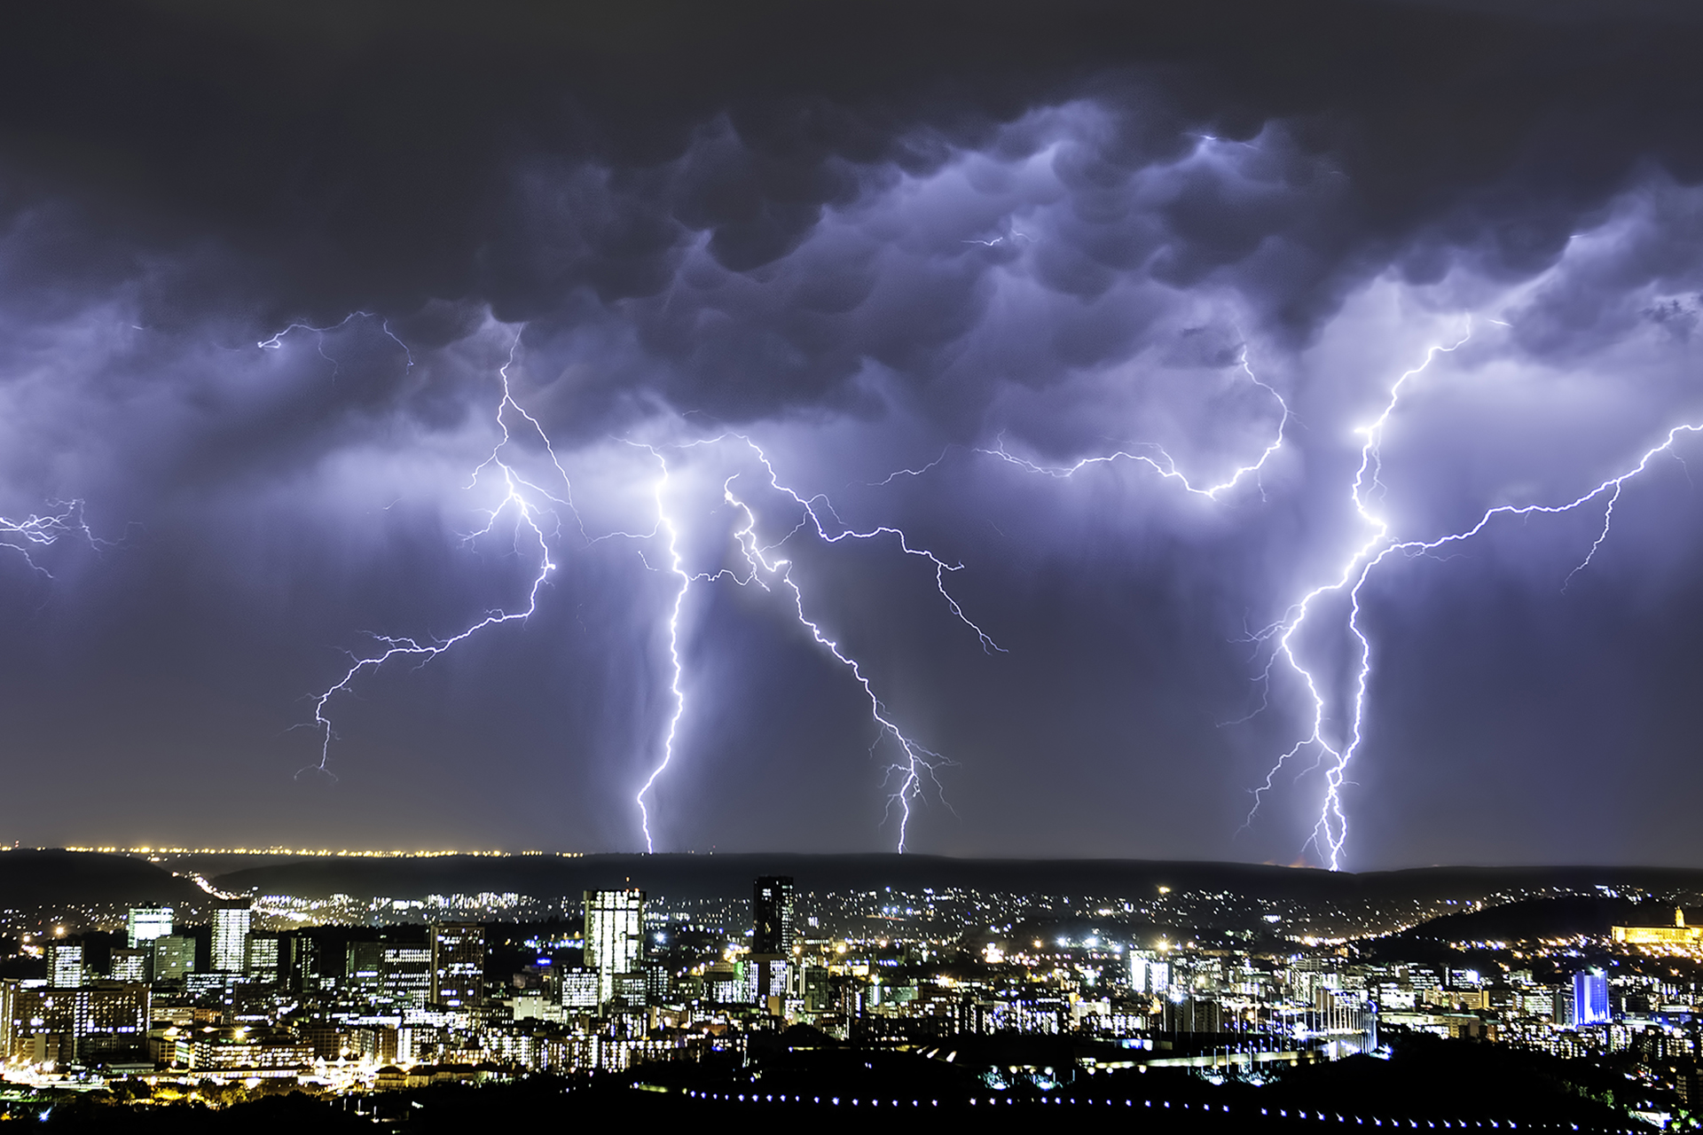
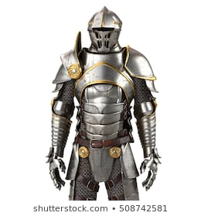
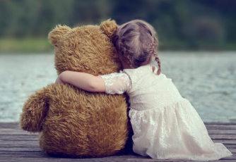
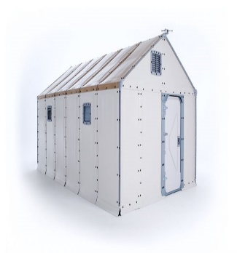
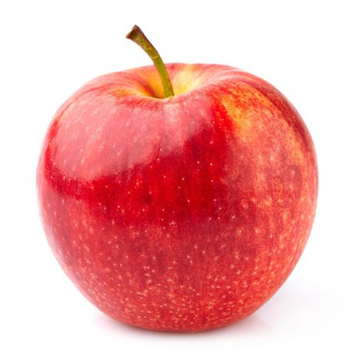
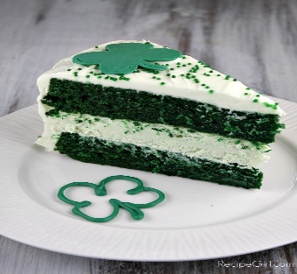
There is a storm!
What should Snowball use to protect himself?
Apple
Green Cake
Armor
Hug
Shelter

Slide 13
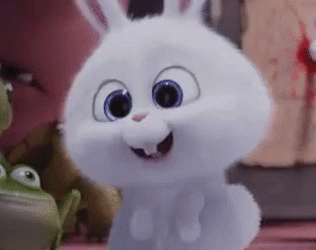
That is the correct choice!
You are awesome!

Slide 14
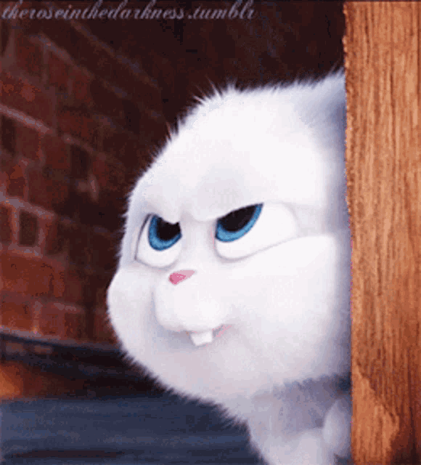
That is not the correct answer!
Let´s try again!

Slide 15
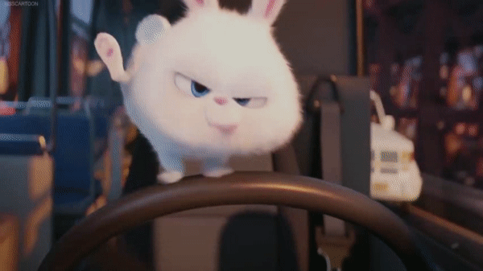
Well done, you did help Snowball!
Today we learned about the weathers.
If it is sunny, we must protect our skin.
When it is raining, we have to keep dry.
We must stay warm when snows.
When storms happens, we must shelter at safe places.

